Slide 1
Object Recognition Using Correlation of 2D Histograms
Kalev Roomann-Kurrik
Digital Signal Processing Design – Fall 2010
Rabiner

Slide 2
Object Recognition
Object Recognition – the task of finding a given object in an image or video sequence
A broad topic with a variety of implementations
  Recognition by Parts (Binford)
  Appearance-based Methods
  Correlation
Numerous applications
  Tracking
  Navigation
  Content-based Image Indexing

Slide 3
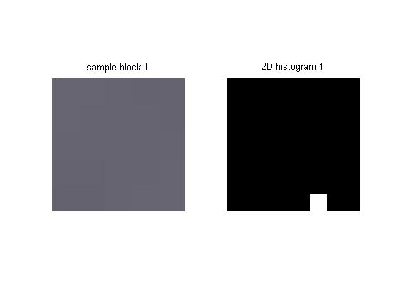
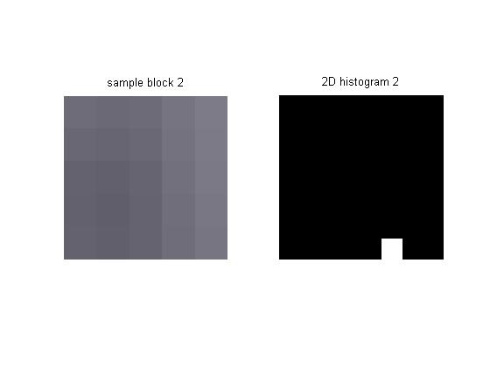
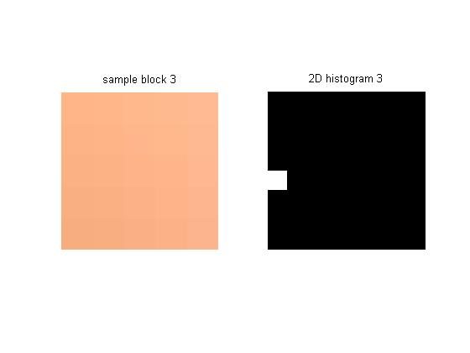
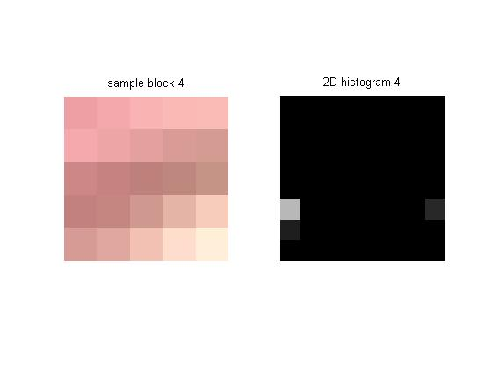
2D Histogram Correlation
What is 2D Histogram Correlation?
Why use it for Object Recognition?
HSI Colorspace vs. RGB Colorspace

Slide 4
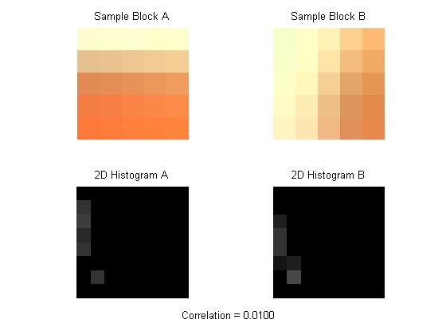
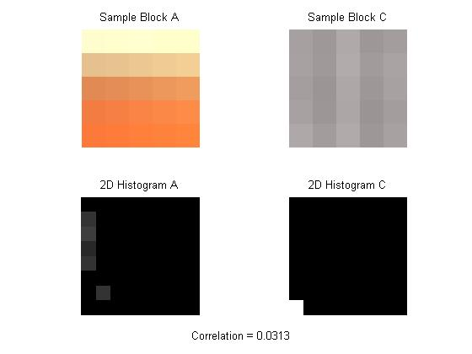
Comparing 2D Histograms
We have characteristics of images (or parts of images). What do we do now?

Slide 5
Block-based Processing
Can compare 2D histograms but limits in comparing two full images
Block-based processing much better for determining if an object is present in an image and its location if it is present
Finding the correct block size
Have to consider factors such as accuracy and speed
How do we represent our results?

Slide 6
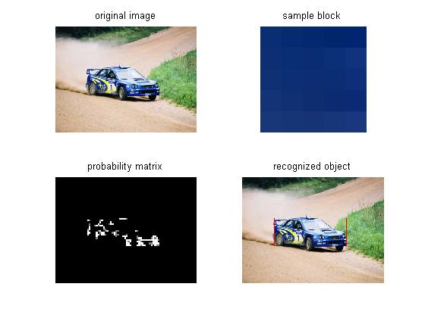
Probability Matrix Image
Produced based off of correlation values of each block in the image versus a sample block (of the object)

Slide 7
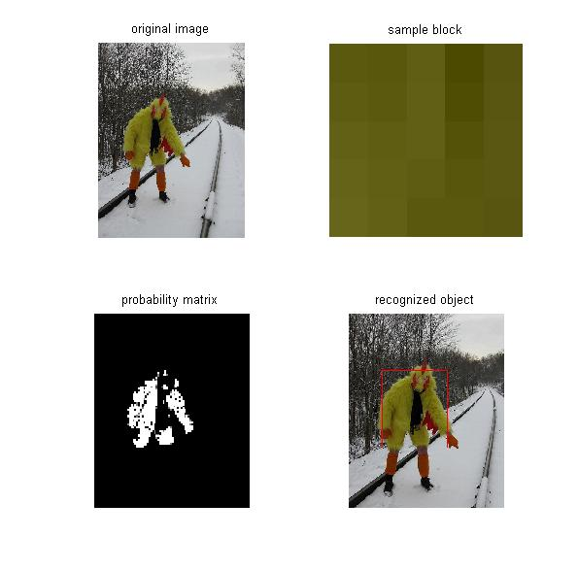
Object Recognition Examples

Slide 8
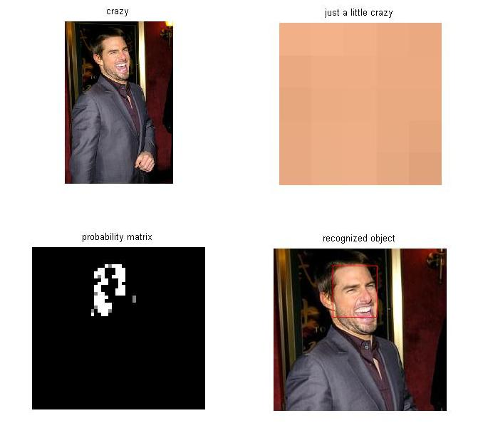
Object Recognition Examples

Slide 9
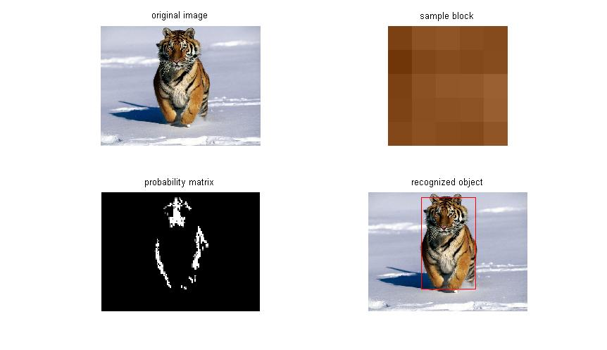
Object Recognition Examples

Slide 10
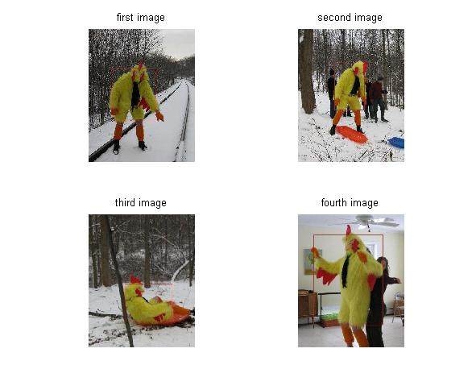
Mean Value Tracking
An alternative to comparing against a sample block
Can be used to identify same object in multiple images (such as a video sequence for tracking)

Slide 11
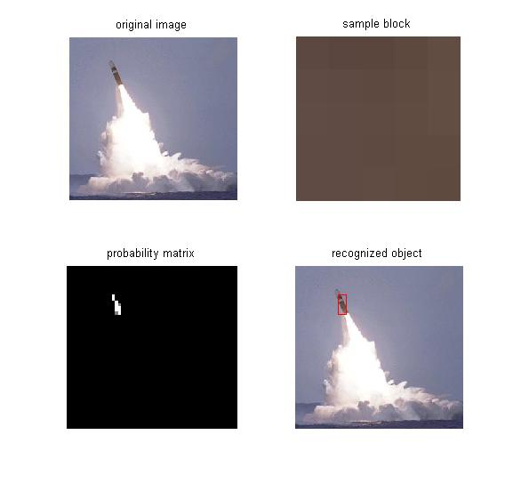
Advantages of Method
Simple and easy to implement
Can be very effective for certain tasks

Slide 12
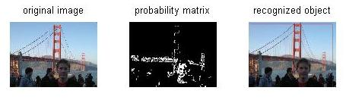
Limitations of Method
Requires contrast between object and background
Can be improved by increasing dimensionality of histograms and other techniques

Slide 13
Further Applications
Tracking across images
Integration with robotics
Gesture recognition with FSM
Combined with other DSP methods to produce more robust object recognition

Slide 14
Applied DSP Design
All functions used were written from scratch
Based off of many of the ideas that we have learned this semester
  Histograms
  Colorspaces
  Correlation
  Neighborhood processing

Slide 15
The End

